Slide 1
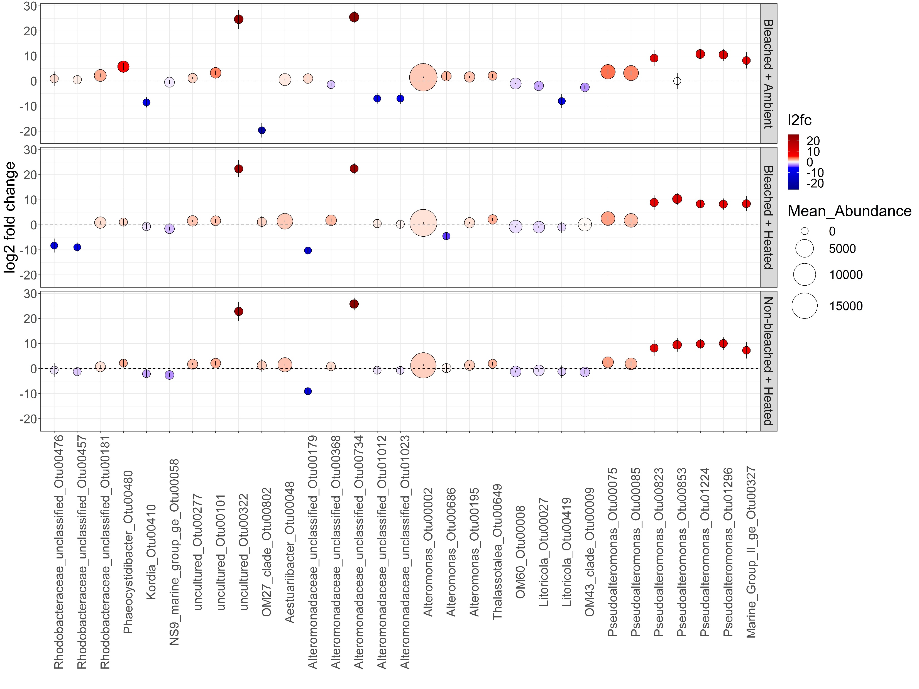
*
*
*
*
*
*
*
*
*
*
*
*
*
*
*
*
*
*
*
*
*
*
*
*
*
*
*
*
*
*
*
*
*
*
*
*
*
*
*
*
*
*
*
*
*
*
Halieaceae
Halieaceae
Litoricolaceae
Saprospiraceae
Litoricolaceae
Saprospiraceae
Bdellovibrionaceae
Bdellovibrionaceae
Methylophilaceae
Cryomorphaceae
Colwelliaceae
Methylophilaceae
Marine Group II
Falvobacteriaceae
Marine Group II
Falvobacteriaceae
Pseudoalteromonadaceae
Rhodobacteraceae
Pseudoalteromonadaceae
Rhodobacteraceae
Rhodobacteraceae
Alteromonadaceae
Alphaproteobacteria
Bacteroidia
Deltaproteobacteria
Gammaproteobacteria
Thermoplasmata

